Slide 1
Debating
Tips and
Hints
By Mr Kordyban

Slide 2
Welcome to the world of debating!
Debates are a great way to practise you English!
Be part of a team and have fun while competing!
Debates help all 4 areas of English:
Reading, Speaking, Listening, and Writing.

Slide 3
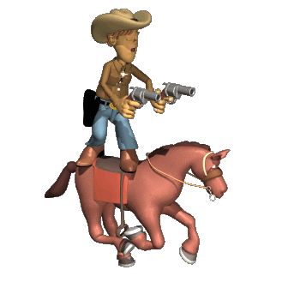
Debates are different from most presentations:
What you say will change depending on what the other teams says, so you need to think on your feet!
It’s almost like the debate is alive!
Simply memorizing a presentation won’t work!

Slide 4
You need to LISTEN , REACT and ADAPT during the debate.
For example
If they attack one of your main points, you need to defend it.
If they say something weak, you need to attack it.
If they ask a question, you need to answer it.

Slide 5
The 3 Pillars of a Strong Debate
Make & Support Your Team’s Points
Clearly identify your teams main points, but give each point its own space, don’t bunch them together.
Provide support such as statistics, quotes, examples (with their sources).
Unify the speakers with a “team line” or main slogan/theme which is repeated and reinforced by each speaker.
Be sure to include a quick summary of your main points.
Prepare a defense of your weak points & against the other team’s likely rebuttal.
make your
attack their
delivery
points
points

Slide 6
The 3 Pillars of a Strong Debate
Aggressively Attack your Oponnent’s Points
Plan your attack. Have rebuttal cards made up in advance for likely points the opponents will make.
Always have someone listen to what the other side is saying. Jot down quotes.
Start off your 2nd & 3rd speakers with vigorous rebuttals. Be polite, but aggressive. Use support for your criticism (stats, quotes, examples etc).
Contrast their weaker points with your stronger points for added effect.
make & support
attack their
delivery
your points
points

Slide 7
The 3 Pillars of a Strong Debate
Have a Solid Delivery
DO NOT read your notes from cards.
Body language such as gestures, facial expressions, & eye contact are important.
Remember sometimes less is more. Speak slowly and directly Pause between points for effect and emphasis.
Speak loudly, clearly, and with good pronunciation. Simplify words that might be a pronunciation problem.
Be aware of timing and use the allotted time smoothly and effectively.
Use proper English and avoid grammar mistakes without trying to “overdo it”.
make & support
attack their
delivery
your points
points

Slide 8
Also, remember that a debate is NOT an English language gunfight.
Don’t try to use too many difficult words or fancy sentence structures.
Often making your point in a simple and clear way is better.
It is universally recognised that felines are greatly superior to canines with respect to personal hygiene and grooming.
Cats are cleaner than dogs.

Slide 9
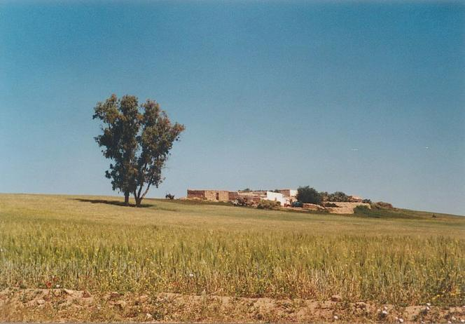
Top 10 Things to Remember

Slide 10
3
Simplify & be direct
when you plan.
Use point form/mind map notes
2
Know the other side’s argument. Look at it from their perspective
1
Listen, adapt and think on your feet
4
Practise your debate and work as a team!
10 Things to Remember for your Debate
7
Try to relax, smile and have fun
5
Know the system: marking scheme, time limits, speaker roles
6
Have a dynamic delivery style and loud clear speech
10
Relate points back to your team line. Use summaries and conclusions.
8
Slow down. Use pauses for effect Give each point its own time
9
Be prepared. Do research. Prepare possible rebuttals

Slide 11
Top 10 Things to Avoid

Slide 12
2
Avoid “SUPERMAN ENGLISH” effect
1
Don’t be too serious or boring. Have fun and be dynamic!
3
Never be impolite or rude
4
Don’t read your notes- remember eye contact!
The Top Ten things to Avoid (Debate Killers)
7
Don’t go over the time limit. Listen for the warning bells
5
No over-exaggerated statements !
6
Don’t treat the debate like saying a memorised essay or composition.
8
Don’t forget the big picture (team line)
9
Watch pronunciation problems
10
Don’t speak too fast, use some pauses effectively

Slide 13
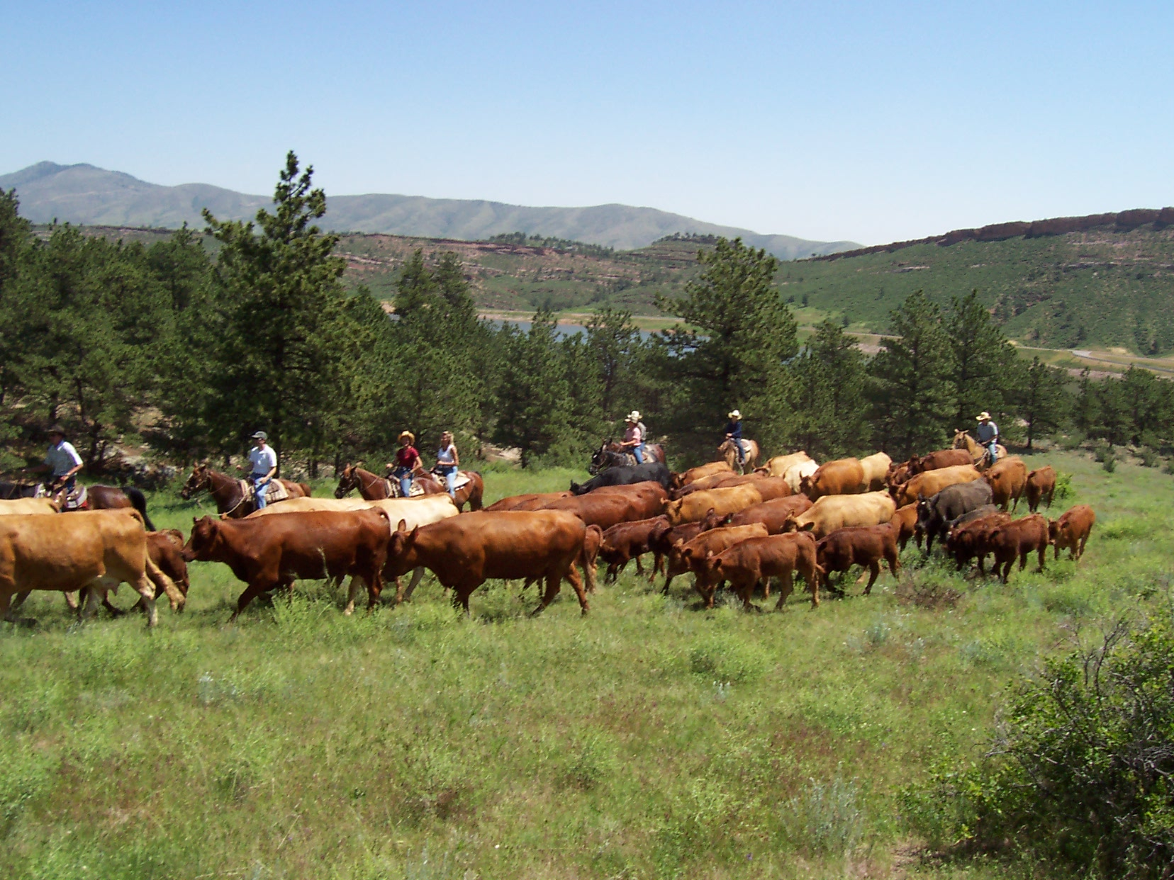
PLAN

Slide 14
PLAN
Brainstorm ideas then choose the best ones
Make a mind map with point form notes
Do the same thing for your opponents
can protect you
don’t need walks
friendly
cleaner
Dogs are better pets for Hong Kong
more trendy
Cats are better pets for Hong Kong
don’t
bark
cheaper to feed
different sizes
smaller for apartments
affectionate

Slide 15
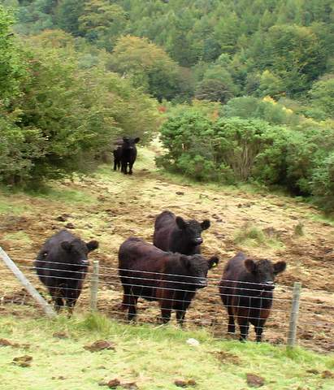
PREPARE

Slide 16
PREPARE
Find support for your points (research) write a different card for each point.
Think of ways to attack your opponents’ points
Be aware of the roles for each speaker
Don’t forget about the time limits
You have three minutes for each speaker
2:30 – single bell
3:00 double bell
3:15 continuous bell

Slide 17
Speakers’ Roles
Affirmative Side | Negative Side
1st Give a greeting Define/explain the motion Outline the team line Introduce the speakers & roles Present own argument & summary | 1st Give a greeting Define/explain/compare the motion Outline the team line Introduce the speakers & roles Present own argument & summary
2nd Rebuttal: Criticize the other’s sides points with reasons and support. Develop your points, and give support and examples for your ideas. Summarize & connect to team line | 2nd Rebuttal: Criticize the other’s sides points with reasons and support. Develop your points, and give support and examples for your ideas. Summarize & connect to team line
3rd Review and compare both sides Combine rebuttal of their points & support for your own points. No new material introduced! Give a strong conclusion and refer the team line to the debate motion. | 3rd Review and compare both sides Combine rebuttal of their points & support for your own points. No new material introduced! Give a strong conclusion and refer the team line to the debate motion.

Slide 18
Elements of a Debate
Matter: the content
Manner: the style & delivery
Method: the structure/organisation

Slide 19
Elements of a Debate
MATTER | MANNER | METHOD
Ideas & arguments | Eye Contact | Fulfilling speakers’ roles
Facts & opinions | Voice quality | Team work
Evidence & examples | Gestures & Body language | Effective use of the time allowed
Quotations & statistics | Confidence & humour | Good structures (e.g. intro/body/conclusion)
Try to do well in each of these sections!

Slide 20
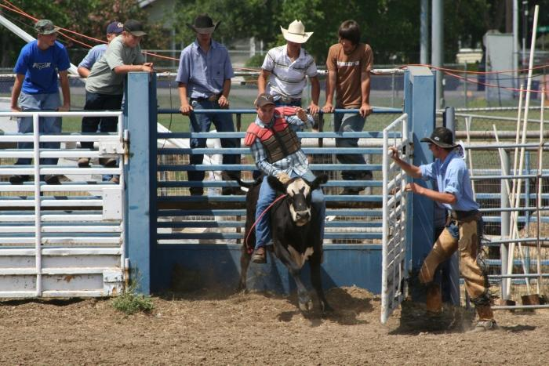
PRACTISE

Slide 21
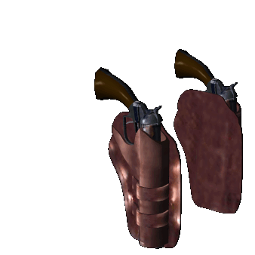
PRACTISE
Have a separate card for each point and practise giving your delivery. Time it to see how long it takes.
Remember to work as a group. Practise with the others in your group so you know what they will say.
Practise rebuttals by imagining what they will say. Have different cards ready for their possible points. Be prepared to think fast if they have some new ideas

Slide 22
Let’s watch a debate !
It’s a great way to learn about debating.

